Slide 1
Programming with OpenGL
Part 3: Three Dimensions
Angel: Interactive Computer Graphics 5E © Addison-Wesley 2009

Slide 2
Objectives
Develop a more sophisticated three-dimensional example
  Sierpinski gasket: a fractal
Introduce hidden-surface removal
Angel: Interactive Computer Graphics 5E © Addison-Wesley 2009

Slide 3
Three-dimensional Applications
In OpenGL, two-dimensional applications are a special case of three-dimensional graphics
Going to 3D
  Not much changes
  Use glVertex3*( )
  Have to worry about the order in which polygons are drawn or use hidden-surface removal
  Polygons should be simple, convex, flat
Angel: Interactive Computer Graphics 5E © Addison-Wesley 2009

Slide 4
Sierpinski Gasket (2D)
Start with a triangle
Connect bisectors of sides and remove central triangle
Repeat
Angel: Interactive Computer Graphics 5E © Addison-Wesley 2009

Slide 5
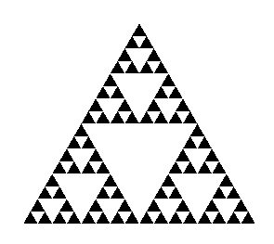
Example
Five subdivisions
Angel: Interactive Computer Graphics 5E © Addison-Wesley 2009

Slide 6
The gasket as a fractal
Consider the filled area (black) and the perimeter (the length of all the lines around the filled triangles)
As we continue subdividing
  the area goes to zero
  but the perimeter goes to infinity
This is not an ordinary geometric object
  It is neither two- nor three-dimensional
It is a fractal (fractional dimension) object
Angel: Interactive Computer Graphics 5E © Addison-Wesley 2009

Slide 7
Gasket Program
#include <GL/glut.h>
/* initial triangle */
GLfloat v[3][2]={{-1.0, -0.58},
{1.0, -0.58}, {0.0, 1.15}};
int n; /* number of recursive steps */
Angel: Interactive Computer Graphics 5E © Addison-Wesley 2009

Slide 8
Draw one triangle
void triangle( GLfloat *a, GLfloat *b, GLfloat *c)
/* display one triangle */
{
glVertex2fv(a);
glVertex2fv(b);
glVertex2fv(c);
}
Angel: Interactive Computer Graphics 5E © Addison-Wesley 2009

Slide 9
Triangle Subdivision
void divide_triangle(GLfloat *a, GLfloat *b, GLfloat *c, int m)
{
/* triangle subdivision using vertex numbers */
point2 v0, v1, v2;
int j;
if(m>0)
{
for(j=0; j<2; j++) v0[j]=(a[j]+b[j])/2;
for(j=0; j<2; j++) v1[j]=(a[j]+c[j])/2;
for(j=0; j<2; j++) v2[j]=(b[j]+c[j])/2;
divide_triangle(a, v0, v1, m-1);
divide_triangle(c, v1, v2, m-1);
divide_triangle(b, v2, v0, m-1);
}
else(triangle(a,b,c));
/* draw triangle at end of recursion */
}
Angel: Interactive Computer Graphics 5E © Addison-Wesley 2009

Slide 10
display and init Functions
void display()
{
glClear(GL_COLOR_BUFFER_BIT);
glBegin(GL_TRIANGLES);
divide_triangle(v[0], v[1], v[2], n);
glEnd();
glFlush();
}
void myinit()
{
glMatrixMode(GL_PROJECTION);
glLoadIdentity();
gluOrtho2D(-2.0, 2.0, -2.0, 2.0);
glMatrixMode(GL_MODELVIEW);
glClearColor (1.0, 1.0, 1.0,1.0)
glColor3f(0.0,0.0,0.0);
}
Angel: Interactive Computer Graphics 5E © Addison-Wesley 2009

Slide 11
main Function
int main(int argc, char **argv)
{
n=4;
glutInit(&argc, argv);
glutInitDisplayMode(GLUT_SINGLE|GLUT_RGB);
glutInitWindowSize(500, 500);
glutCreateWindow(“2D Gasket");
glutDisplayFunc(display);
myinit();
glutMainLoop();
}
Angel: Interactive Computer Graphics 5E © Addison-Wesley 2009

Slide 12
Efficiency Note
By having the glBegin and glEnd in the display callback rather than in the function triangle and using GL_TRIANGLES rather than GL_POLYGON in glBegin, we call glBegin and glEnd only once for the entire gasket rather than once for each triangle
Angel: Interactive Computer Graphics 5E © Addison-Wesley 2009

Slide 13
Moving to 3D
We can easily make the program three-dimensional by using
GLfloat v[3][3]
glVertex3f
glOrtho
But that would not be very interesting
Instead, we can start with a tetrahedron
Angel: Interactive Computer Graphics 5E © Addison-Wesley 2009

Slide 14
3D Gasket
We can subdivide each of the four faces
Appears as if we remove a solid tetrahedron from the center leaving four smaller tetrahedra
Angel: Interactive Computer Graphics 5E © Addison-Wesley 2009

Slide 15
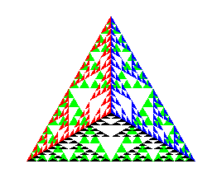
Example
after 5 iterations
Angel: Interactive Computer Graphics 5E © Addison-Wesley 2009

Slide 16
triangle code
void triangle( GLfloat *a, GLfloat *b, GLfloat *c)
{
glVertex3fv(a);
glVertex3fv(b);
glVertex3fv(c);
}
Angel: Interactive Computer Graphics 5E © Addison-Wesley 2009

Slide 17
subdivision code
void divide_triangle(GLfloat *a, GLfloat *b, GLfloat *c, int m)
{
GLfloat v1[3], v2[3], v3[3];
int j;
if(m>0)
{
for(j=0; j<3; j++) v1[j]=(a[j]+b[j])/2;
for(j=0; j<3; j++) v2[j]=(a[j]+c[j])/2;
for(j=0; j<3; j++) v3[j]=(b[j]+c[j])/2;
divide_triangle(a, v1, v2, m-1);
divide_triangle(c, v2, v3, m-1);
divide_triangle(b, v3, v1, m-1);
}
else(triangle(a,b,c));
}
Angel: Interactive Computer Graphics 5E © Addison-Wesley 2009

Slide 18
tetrahedron code
void tetrahedron( int m)
{
glColor3f(1.0,0.0,0.0);
divide_triangle(v[0], v[1], v[2], m);
glColor3f(0.0,1.0,0.0);
divide_triangle(v[3], v[2], v[1], m);
glColor3f(0.0,0.0,1.0);
divide_triangle(v[0], v[3], v[1], m);
glColor3f(0.0,0.0,0.0);
divide_triangle(v[0], v[2], v[3], m);
}
Angel: Interactive Computer Graphics 5E © Addison-Wesley 2009

Slide 19
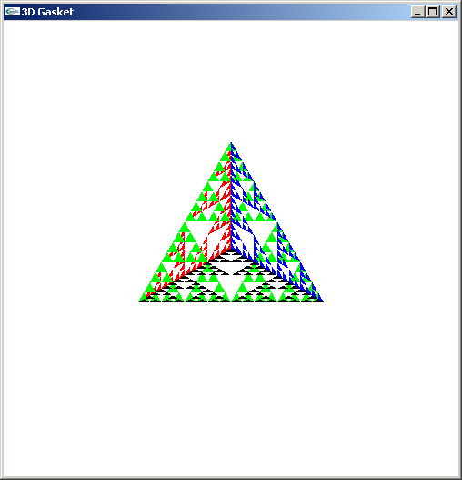
Almost Correct
Because the triangles are drawn in the order they are defined in the program, the front triangles are not always rendered in front of triangles behind them
get this
want this
Angel: Interactive Computer Graphics 5E © Addison-Wesley 2009

Slide 20
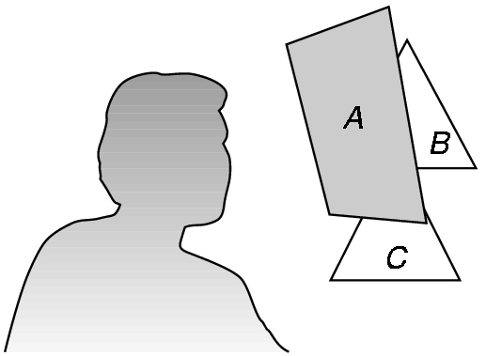
Hidden-Surface Removal
We want to see only those surfaces in front of other surfaces
OpenGL uses a hidden-surface method called the z-buffer algorithm that saves depth information as objects are rendered so that only the front objects appear in the image
Angel: Interactive Computer Graphics 5E © Addison-Wesley 2009

Slide 21
Using the z-buffer algorithm
The algorithm uses an extra buffer, the z-buffer, to store depth information as geometry travels down the pipeline
It must be
  Requested in main.c
    glutInitDisplayMode
    (GLUT_SINGLE | GLUT_RGB | GLUT_DEPTH)
  Enabled in init.c
    glEnable(GL_DEPTH_TEST)
  Cleared in the display callback
    glClear(GL_COLOR_BUFFER_BIT |
    GL_DEPTH_BUFFER_BIT)
Angel: Interactive Computer Graphics 5E © Addison-Wesley 2009

Slide 22
Surface vs Volume Subdvision
In our example, we divided the surface of each face
We could also divide the volume using the same midpoints
The midpoints define four smaller tetrahedrons, one for each vertex
Keeping only these tetrahedrons removes a volume in the middle
See text for code
Angel: Interactive Computer Graphics 5E © Addison-Wesley 2009

Slide 23
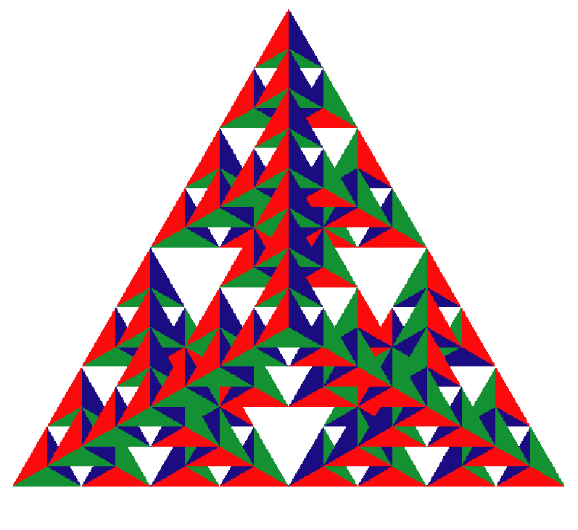
Volume Subdivision
Angel: Interactive Computer Graphics 5E © Addison-Wesley 2009

